Slide 1
CSIS-210 Fall 2016 Lecture 14
Questions about Project 2 ?
String Compares
Two Dimensional (2-D) Arrays
Homework: zyBooks 7.9

Slide 2
Lazy System.out.println()
private static void sout (Object o)
{ System.out.println(o); }
In main:
sout(”Hello”);
Also: StringCompare demo Fall 2016

Slide 3
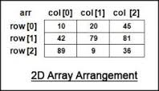
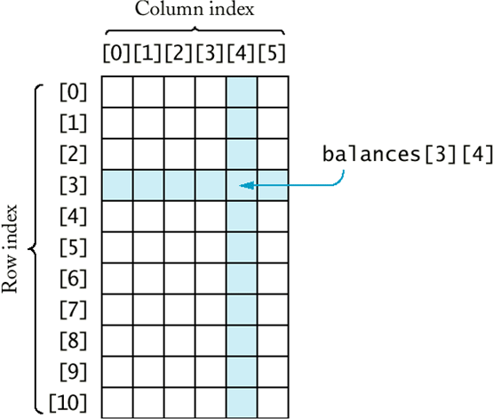
2-D arrays (matrix) conceptual view by humans

Slide 4
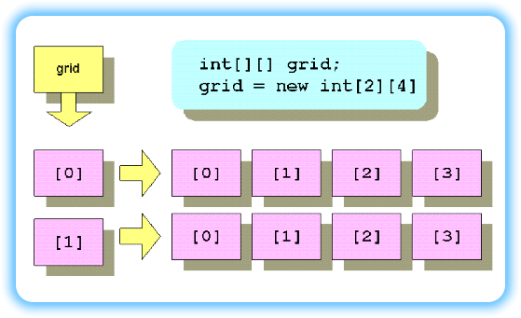
Matrix (table) internal view
Note: int [ ] [ ] grid only defines a reference variable, no space is allocated until NEW is executed!
Also: new int [2] [4]
Defines two reference variables pointing to 1-D arrays of size 4.

Slide 5
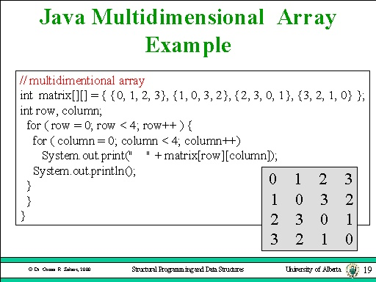
Processing 2D arrays

Slide 6
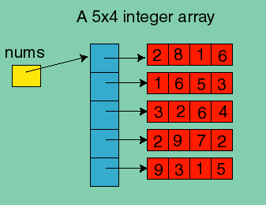
int [ ] [ ] nums; // how much space is allocated?
int [ ] [ ] nums = new int[5] [ ];
int [ ] [ ] nums = new int[5] [4];
// 2D array DEMO

Slide 7
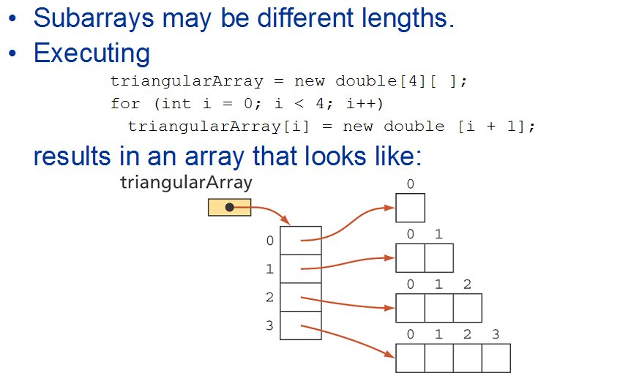

Slide 8
Processing 2D arrays: sum each row in the array
int [ ] [ ] scores = { {2,3,6,1}, {6, 1, 12, 14} };
// what does scores.length represent?
for (int i=0; i<scores.length; i++) {
int rowSum =0; // for each row
// what does scores[i].length represent ?
for (int j=0; j< scores[i].length; j++)
{ rowSum += scores[i] [j]; }
System.out.println(“Sum of row “ + i + ” = “ + rowSum);
}

Slide 9
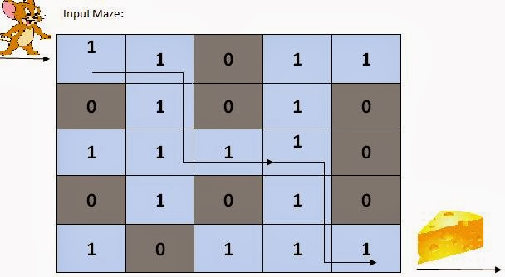
Good recursion: Maze Traversal
Recursion will be used to keep track of the path through a maze (represented by a 2D array) using the run-time stack.
The stack keeps track of the visited paths, and allows us to “backtrack” to new paths

Slide 10
Maze Traversal
The base case is:
arrival at the final destination
Recursive case:
check path in U/D/L/R direction IF NOT BLOCKED

Slide 11
Search maze 0=blocked
int maze[][] = {
{1 , 1, 0, 1, 1},
{0 , 1, 0, 1, 0},
{1 , 1, 1, 1, 0},
{0 , 1, 0, 1, 0},
{1 , 0, 1, 1, 1}
};
solvemaze(maze, 5,5, 0,0,4,4);
// name of array, rows, cols, startX, startY, endX, endY

Slide 12
Base case
public static void solvemaze(int[][] maze, int rows, int cols, int startX, int startY, int endX, int endY)
{ // search until we get to end position or exhaust search
System.out.println("Start: ["+startX+"]["+startY+"] End: ["+endX+"]["+endY+"]");
// base case
if ( (startX == endX) && (startY == endY) )
{ System.out.println("Maze solved!");
return;
}

Slide 13
Prevent endless search
// After base case
maze[startX][startY]=0; // mark visited
Otherwise, we will search DOWN from current cell
Then eventually Search UP back to original cell, then search DOWN, etc……

Slide 14
Search in 4 directions
// inductive case – search UP, DOWN, LEFT, RIGHT
// current cell is startX, startY
// search UP
IF (we are not on TOP ROW)
{ IF (the cell ABOVE current cell is not blocked)
{call solvemaze using the ABOVE cell as starting cell.}
}
// search DOWN in similar fashion
// search LEFT in similar fashion
// search RIGHT in similar fashion
}
// MAZE DEMO

Slide 15
Demo and homework activity
2-D arrays and recursive maze example
zyBooks do 7.9 (intro 2-D arrays)
Previous zyBook assignments:
12.1 – 12.3 Recursion
22.1-22.4 and 22.8 – 22.13 Stack/Queue
4.1-4.8 and 7.1-7.4 data types & arrays

